Slide 1


Cleiton Otavio da Exaltação Rocha
25/12/2021

Slide 2

Outline
Executive Summary
Introduction
Methodology
Results
Conclusion
Appendix

Slide 3
Executive Summary
Summary of methodologies
Summary of all results

Slide 4
Introduction
Project background and context
Problems you want to find answers

Slide 5


Slide 6
Methodology
Executive Summary
Data collection methodology:
Describe how data was collected
Perform data wrangling
Describe how data was processed
Perform exploratory data analysis (EDA) using visualization and SQL
Perform interactive visual analytics using Folium and Plotly Dash
Perform predictive analysis using classification models
How to build, tune, evaluate classification models

Slide 7
Data Collection
Data were collected through two processes: 1) Webscrapping, where in this case information from a website is collected, stored and later analyzed and 2) through an API, which in short is a program that bridges the gap between the data request and its source.
1 – Webscrapping
2 – API

Slide 8
Data Collection – SpaceX API
A request of type 'GET' is made to get the information back in a JSON format. After that, the JSON is transformed into a dataframe in Pandas format, ready for analysis
https://github.com/CleitonOERocha/IBM_DS_Final_Project/blob/main/jupyter-labs-spacex-data-collection-api.ipynb
1 – Link:
spacex_url="https://api.spacexdata.com/v4/launches/past"
2 – GET Requistion:
response = requests.get(spacex_url)
3 – json_normalize:
data = pd.json_normalize(response.json())

Slide 9
Data Collection - Scraping
1 – Link:
static_url="https://en.wikipedia.org/w/index.php?title=List_of_Falcon_9_and_Falcon_Heavy_launches&oldid=1027686922"
Present your web scraping process using key phrases and flowcharts
https://github.com/CleitonOERocha/IBM_DS_Final_Project/blob/main/jupyter-labs-webscraping.ipynb
2 – GET Requisition:
response = requests.get(static_url)
3 – Transform in list:
soup = BeautifulSoup(response.text, "html.parser")
4 – Transform in df:
html_tables = soup.find_all('table')

Slide 10
Data Wrangling
The first step is to load the data using the Pandas 'read_csv' function. After that, some information is extracted from the dataset, namely: 1) the percentage of missing values in each column was calculated. 2) the number of launches at each site was calculated 3) the number and occurrence of the mission result by orbit type was calculated and 4) a landing result label was created in the 'Result' column
https://github.com/CleitonOERocha/IBM_DS_Final_Project/blob/main/labs-jupyter-spacex-Data%20wrangling.ipynb
1 – Link:
df=pd.read_csv("https://cf-courses-data.s3.us.cloud-object-storage.appdomain.cloud/IBM-DS0321EN-SkillsNetwork/datasets/dataset_part_1.csv")
2 – NA Count:
df.isnull().sum()/df.count()*100
3 – Orbit count:
df["Orbit"].value_counts()
4 – Outcome count:
landing_outcomes = df["Outcome"].value_counts()
5 – Outcome Condition:
landing_class = np.where(df["Outcome"] == bad_outcomes, 0, 1)

Slide 11
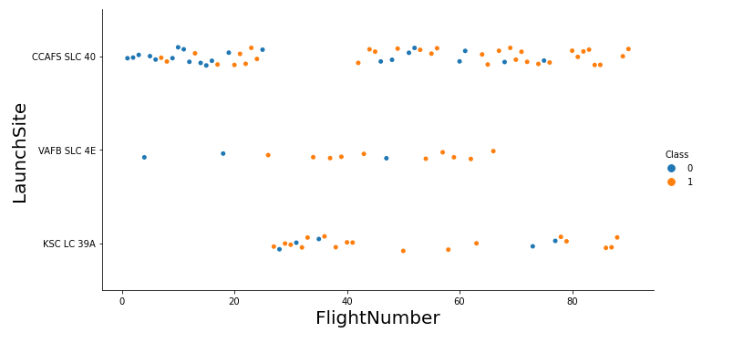
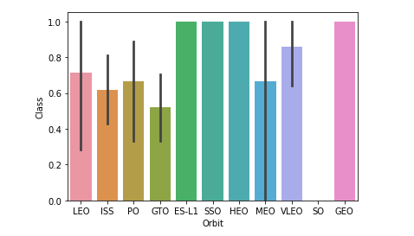
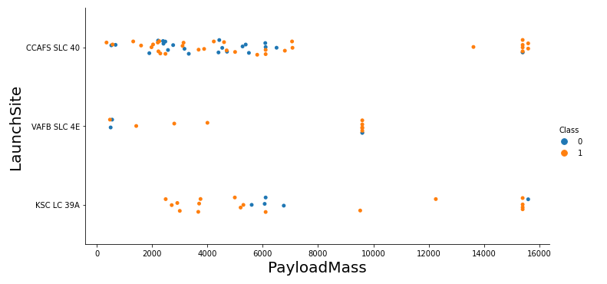
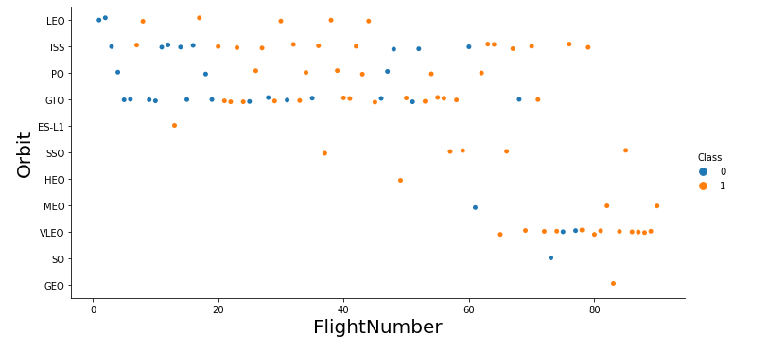
EDA with Data Visualization
The generated graphics serve to understand more quickly some relevant information about the rockets, such as mission success, mass loss, etc.
https://github.com/CleitonOERocha/IBM_DS_Final_Project/blob/main/jupyter-labs-eda-dataviz.ipynb

Slide 12
EDA with SQL
The queries performed were to select variables, group, summarize, filter, among others; Queries are performed using SQL queries through the pandas sql package.
https://github.com/CleitonOERocha/IBM_DS_Final_Project/blob/main/jupyter-labs-eda-sql-coursera.ipynb
SELECT
WHERE
GROUP BY
SUM
COUNT
AVERAGE

Slide 13
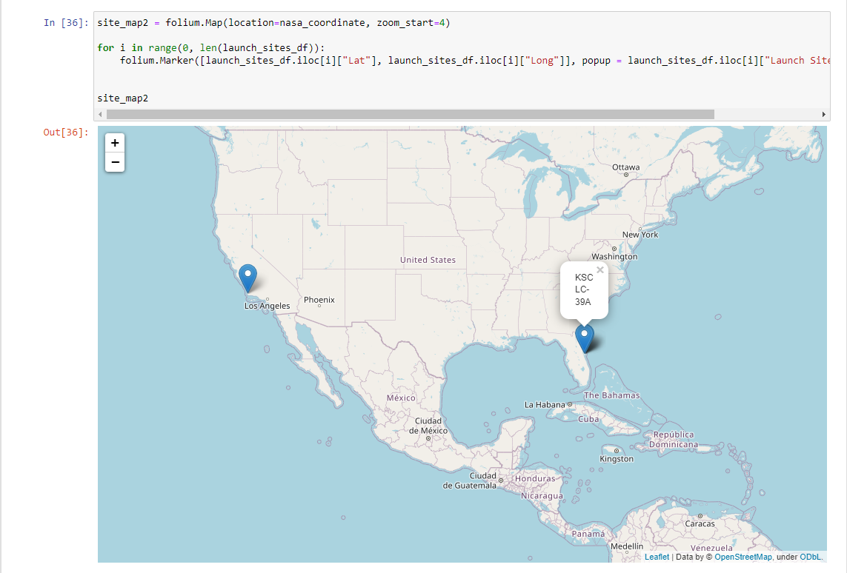
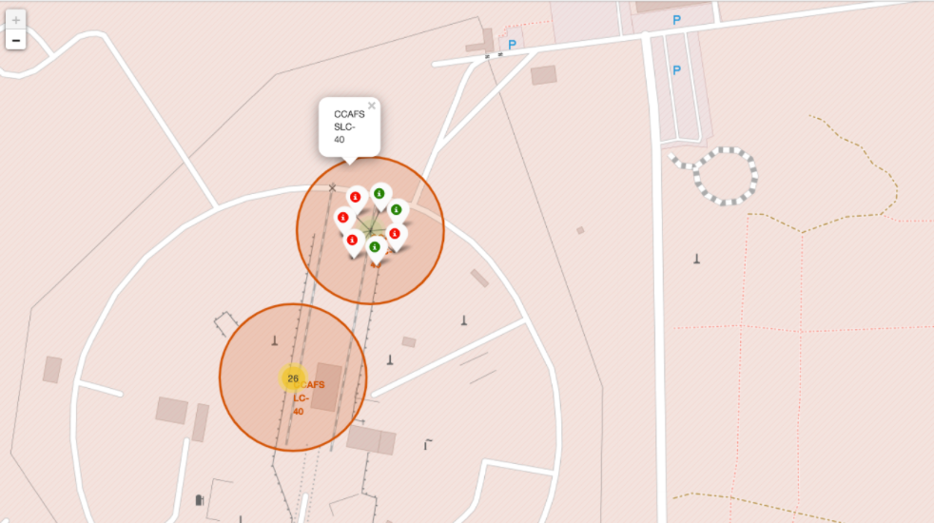
Build an Interactive Map with Folium
The points on the map are for rocket launch locations, through the map you can see where these points are and where they are close to.
https://github.com/CleitonOERocha/IBM_DS_Final_Project/blob/main/lab_jupyter_launch_site_location%20(1).ipynb

Slide 14
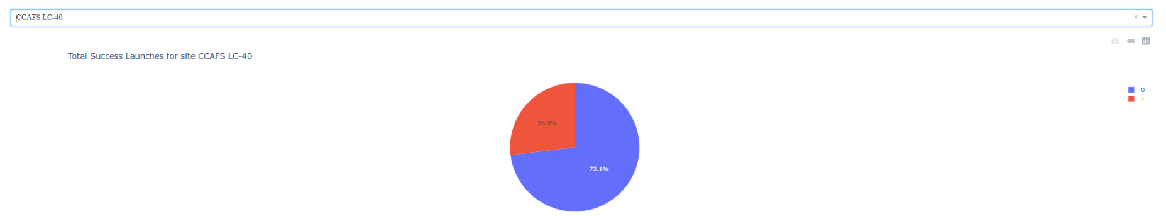
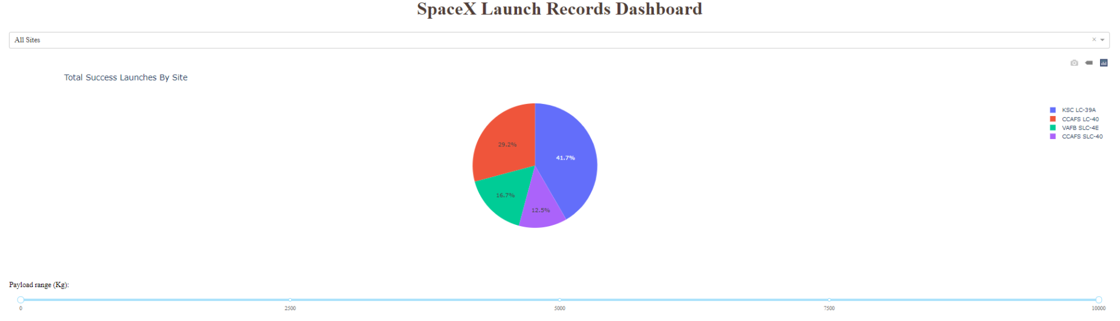
Build a Dashboard with Plotly Dash
The purpose of the dashboard is to observe the behavior of the rockets over time, as well as to see their statistics to understand if the objectives were achieved over time.
https://github.com/CleitonOERocha/IBM_DS_Final_Project

Slide 15
Predictive Analysis (Classification)
1 – Load dataframe:
data = pd.read_csv("https://cf-courses-data.s3.us.cloud-object-storage.appdomain.cloud/IBM-DS0321EN-SkillsNetwork/datasets/dataset_part_2.csv")
The models were built from the sklearn library, each model is built and its results tested to see if the model has good accuracy. The best model is the one with the best accuracy.
https://github.com/CleitonOERocha/IBM_DS_Final_Project/blob/main/SpaceX_Machine%20Learning%20Prediction_Part_5.ipynb
2 – Split in train and test:
X_train, X_test, Y_train, Y_test = train_test_split(X, Y, test_size=0.2, random_state = 2)
3 – Model:
logreg_cv = GridSearchCV(lr, parameters, cv = 10)
4 – Fit model:
logreg_cv.fit(X_train, Y_train)
5 – Accuracy:
print("Tuned Logistic Regression Parameter: {}".format(logreg_cv.best_params_))
print("Tuned Logistic Regression Accuracy: {}".format(logreg_cv.best_score_))

Slide 16
Results
Exploratory data analysis results
Interactive analytics demo in screenshots
Predictive analysis results

Slide 17


Slide 18
Flight Number vs. Launch Site
the graph shows a relationship between locations and number of releases

Slide 19
Payload vs. Launch Site
the graphic shows a relationship between the locations and the payload mass of the postings

Slide 20
Success Rate vs. Orbit Type
Through the bar graph it is possible to notice how the SSO, GEO, ES-LI and HEO orbits stand out

Slide 21
Flight Number vs. Orbit Type
the graphic shows a relationship between the Flight number and the Orbit type.

Slide 22
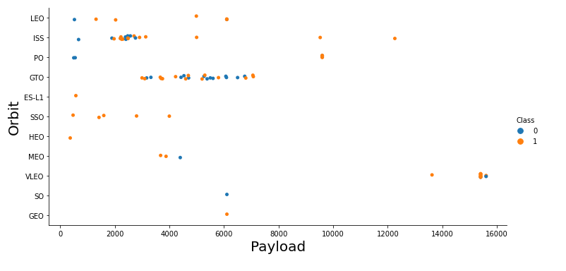
Payload vs. Orbit Type
the graphic shows a relationship between the payload and the Orbit type.

Slide 23
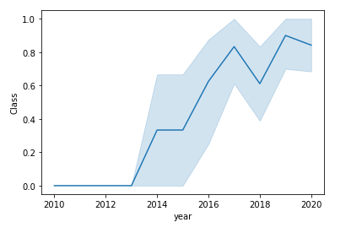
Launch Success Yearly Trend
the graphic shows a yearly average success rate.

Slide 24
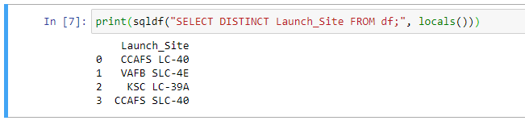
All Launch Site Names
Find the names of the unique launch sites

Slide 25
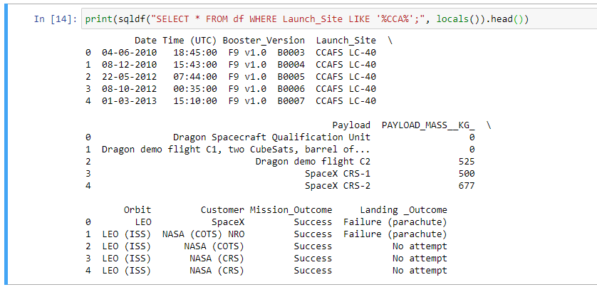
Launch Site Names Begin with 'CCA'
Find 5 records where launch sites begin with `CCA`

Slide 26
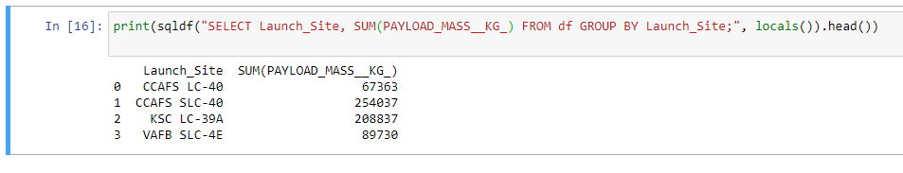
Total Payload Mass
Calculate the total payload carried by boosters from NASA

Slide 27
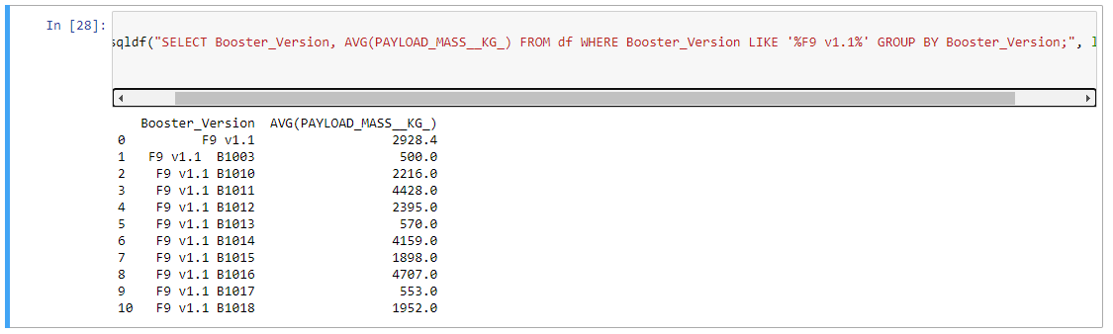
Average Payload Mass by F9 v1.1
Calculate the average payload mass carried by booster version F9 v1.1

Slide 28
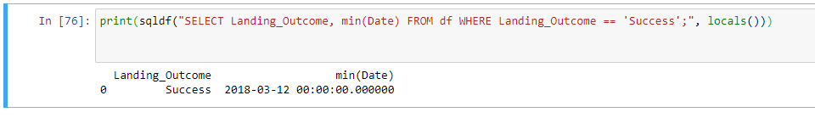
First Successful Ground Landing Date
Find the dates of the first successful landing outcome on ground pad

Slide 29
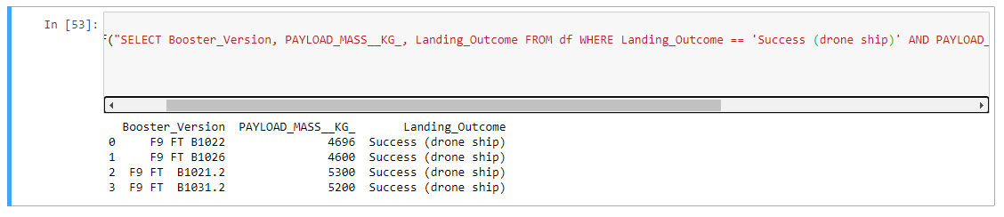
Successful Drone Ship Landing with Payload between 4000 and 6000
List the names of boosters which have successfully landed on drone ship and had payload mass greater than 4000 but less than 6000

Slide 30
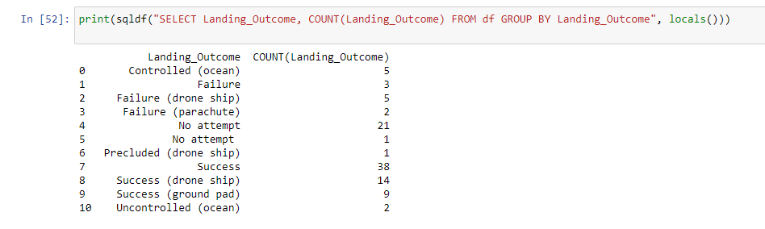
Total Number of Successful and Failure Mission Outcomes
Calculate the total number of successful and failure mission outcomes

Slide 31
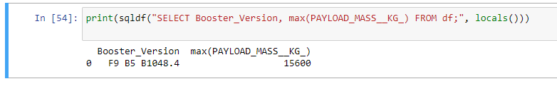
Boosters Carried Maximum Payload
List the names of the booster which have carried the maximum payload mass

Slide 32
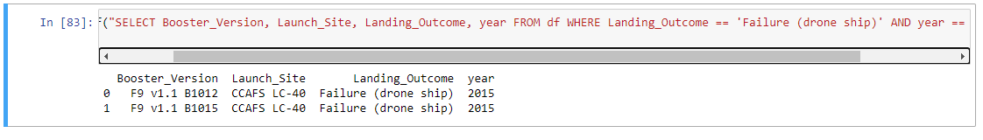
2015 Launch Records
List the failed landing_outcomes in drone ship, their booster versions, and launch site names for in year 2015

Slide 33
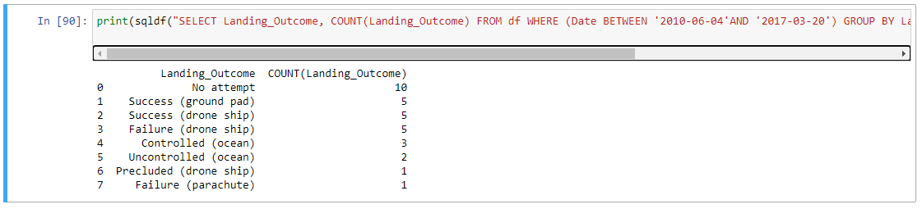
Rank Landing Outcomes Between 2010-06-04 and 2017-03-20
Rank the count of landing outcomes (such as Failure (drone ship) or Success (ground pad)) between the date 2010-06-04 and 2017-03-20, in descending order

Slide 34


Slide 35
Map with locations

Slide 36
Map with locations sucess

Slide 37

Map launch site to its proximities such as railway, highway, coastline

Slide 38


Slide 39
Space X launch records

Slide 40
Total success launches for sites

Slide 41
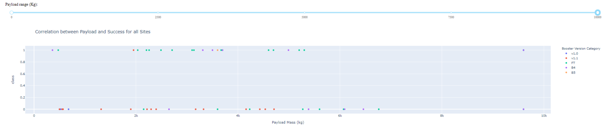
Correlation between payload and success for sites

Slide 42


Slide 43
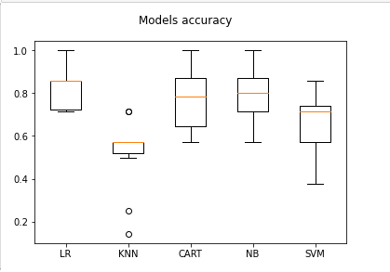
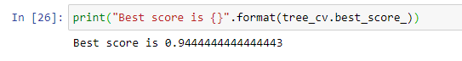
Classification Accuracy
Graph:
Best accuracy:

Slide 44
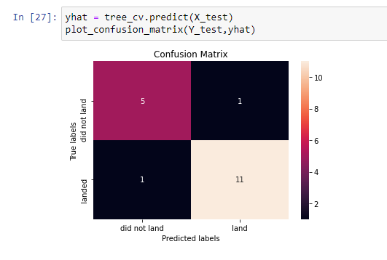
Confusion Matrix
The matrix shows how the model had a high assertiveness, since when comparing actual and predicted values, it proved to be robust in terms of success and minimized errors

Slide 45
Conclusions
Throughout the presentation, it is possible to observe several characteristics of the dataset, which represent the real behavior of Space X's rockets. This is also a demonstration of the company's own strategy. Furthermore, it is also possible to project the success of future missions through machine learning algorithms, which in this case, was the best one by Random Forest.

Slide 46
Appendix
https://github.com/CleitonOERocha/IBM_DS_Final_Project
https://towardsdatascience.com/using-spark-r-to-analyze-emergency-financial-assistance-data-in-brazil-92957e0e25a7

Slide 47


